Slide 1



Slide 2
Chapter 7 – Counters and Registers

Slide 3
Chapter 7 Objectives
Selected areas covered in this chapter:
  Operation & characteristics of synchronous and asynchronous counters.
  Analyzing and evaluating various types of counters.
  Schemes used to decode different types of counters.
  Counter circuits using different levels of abstraction
  in HDL.
  Operation of various types of IC registers.
  Shift registers and shift register counters using HDL.
  Troubleshooting techniques used for combinational logic systems to troubleshoot sequential logic systems.
Digital Systems: Principles and Applications, 11/e
Ronald J. Tocci, Neal S. Widmer, Gregory L. Moss

Slide 4
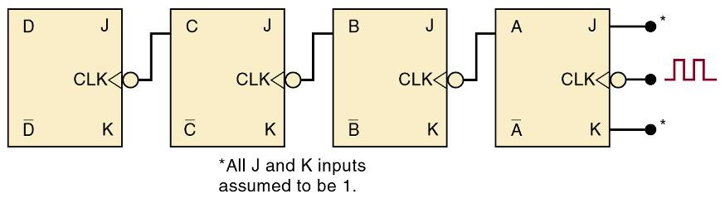
7-1 Asynchronous (Ripple) Counters
Review of four bit counter operation:
  Clock is applied only CLK input to FF A.
    J & K are HIGH in all FFs.
  Output of FF A is CLK of FF B, etc.
    FF outputs D, C, B, and A, are a 4-bit binary
    number with D as the MSB.
Digital Systems: Principles and Applications, 11/e
Ronald J. Tocci, Neal S. Widmer, Gregory L. Moss

Slide 5
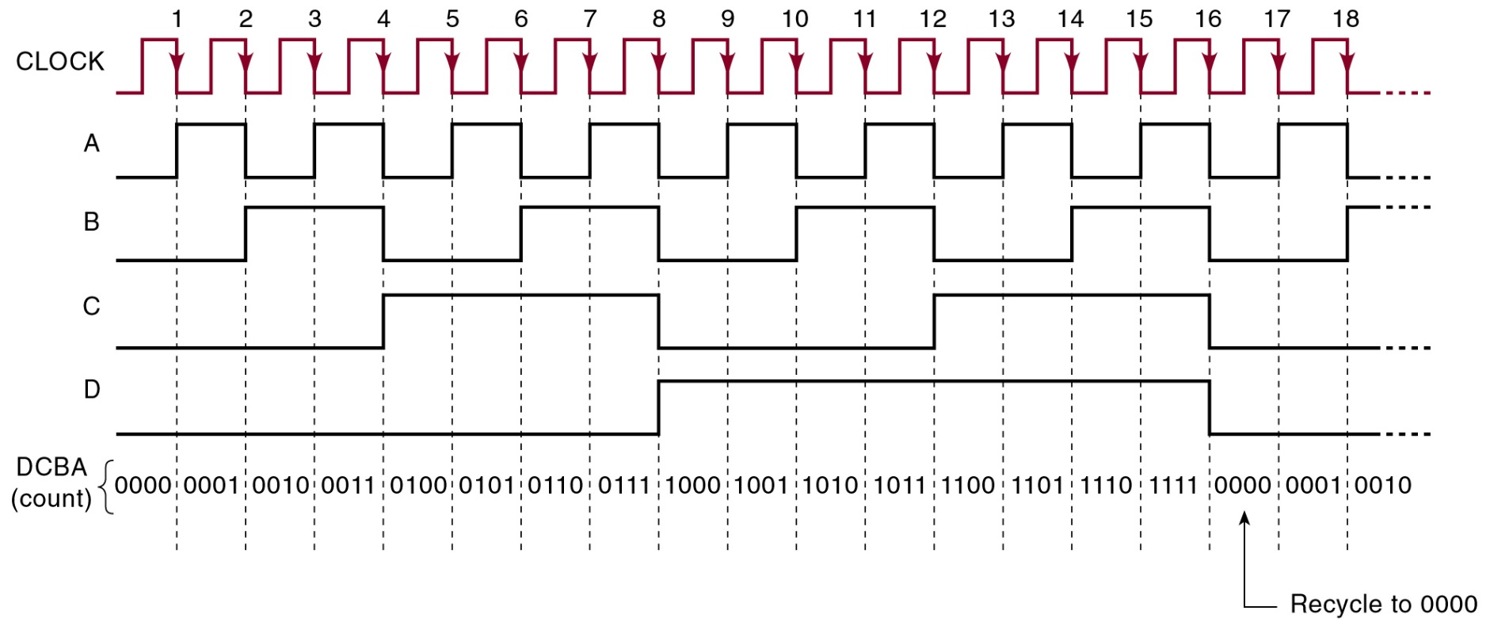
7-1 Asynchronous (Ripple) Counters
Review of four bit counter operation:
  After the NGT of the 15th clock pulse, the counter FFs are recycled back to 0000.
An asynchronous counter—state is not
changed in exact synchronism with the clock.
Digital Systems: Principles and Applications, 11/e
Ronald J. Tocci, Neal S. Widmer, Gregory L. Moss

Slide 6
7-1 Asynchronous (Ripple) Counters – MOD Number
MOD number is equal to the number of states
the counter goes through before recycling.
Adding FFs will increase the MOD number.
Digital Systems: Principles and Applications, 11/e
Ronald J. Tocci, Neal S. Widmer, Gregory L. Moss

Slide 7
7-1 Asynchronous (Ripple) Counters – MOD Number
Frequency division – each FF will have an output frequency of 1/2 the input.
Output frequency of the last counter FF will be clock frequency divided by MOD of the counter.
Digital Systems: Principles and Applications, 11/e
Ronald J. Tocci, Neal S. Widmer, Gregory L. Moss

Slide 8
7-1 Asynchronous (Ripple) Counters – Signal Flow
Schematics are normally drawn from left to right.
  Counters will be drawn from right to left so that the MSB and LSB appear in the appropriate positions.
Digital Systems: Principles and Applications, 11/e
Ronald J. Tocci, Neal S. Widmer, Gregory L. Moss

Slide 9
7-2 Propagation Delay in Ripple Counters
Ripple counters are simple—requiring the fewest components to produce a given operation.
  Cumulative propagation delay can cause problems
  at high frequencies.
If the period between input pulses is made longer than the total propagation delay of the counter, problems can be avoided
  For proper operation: T_{clock} ≥ N x t_{pd}
  Maximum frequency: F_{max}=1/N x t_{pd}
Digital Systems: Principles and Applications, 11/e
Ronald J. Tocci, Neal S. Widmer, Gregory L. Moss

Slide 10
7-2 Propagation Delay in Ripple Counters
Asynchronous counters are not useful at very high frequencies—especially for counters with large numbers of bits.
  Erroneous count patterns can generate glitches
    Signals produced by systems using asynchronous counters.
Digital Systems: Principles and Applications, 11/e
Ronald J. Tocci, Neal S. Widmer, Gregory L. Moss

Slide 11
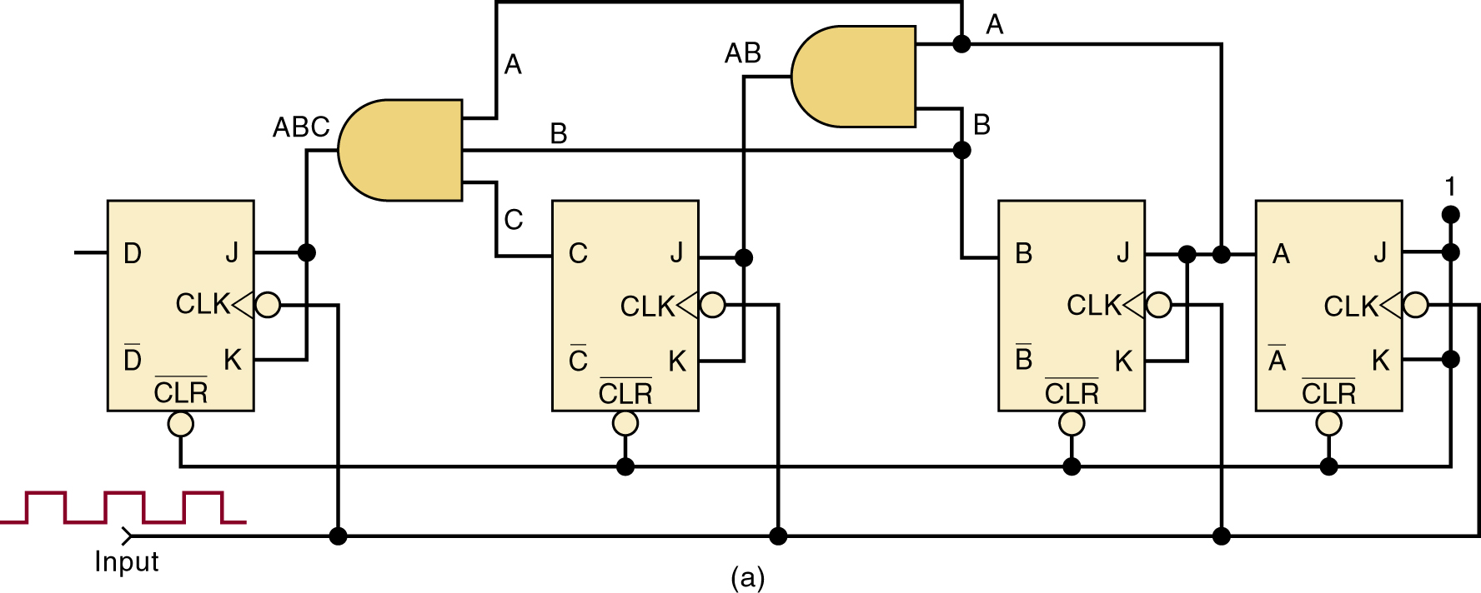
7-3 Synchronous (Parallel) Counters
In synchronous or parallel counters, all FFs are triggered simultaneously (in parallel) by the clock.
Synchronous counters can operate at much
higher frequencies than asynchronous counters.
Digital Systems: Principles and Applications, 11/e
Ronald J. Tocci, Neal S. Widmer, Gregory L. Moss

Slide 12
7-3 Synchronous (Parallel) Counters
Each FF has J & K inputs which are HIGH only when outputs of all lower-order FFs are HIGH.
The total propagation delay will be
the same for any number of FFs.
Digital Systems: Principles and Applications, 11/e
Ronald J. Tocci, Neal S. Widmer, Gregory L. Moss

Slide 13
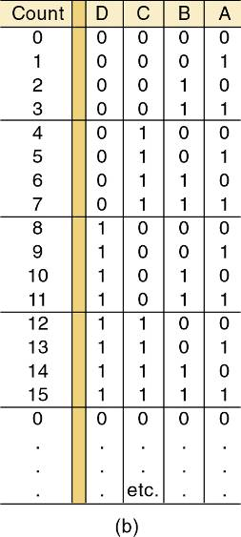
7-3 Synchronous (Parallel) Counters
For this circuit to count properly, on a given NGT of the clock, only those FF that are supposed to toggle on that NGT should have
J = K = 1 when NGT occurs.
Digital Systems: Principles and Applications, 11/e
Ronald J. Tocci, Neal S. Widmer, Gregory L. Moss

Slide 14

7-4 Counters with MOD Number <2^{N}
The basic synchronous counter shown is limited
to MOD numbers that are equal to 2^{N}.
  Where N is the number of FFs.
Digital Systems: Principles and Applications, 11/e
Ronald J. Tocci, Neal S. Widmer, Gregory L. Moss

Slide 15
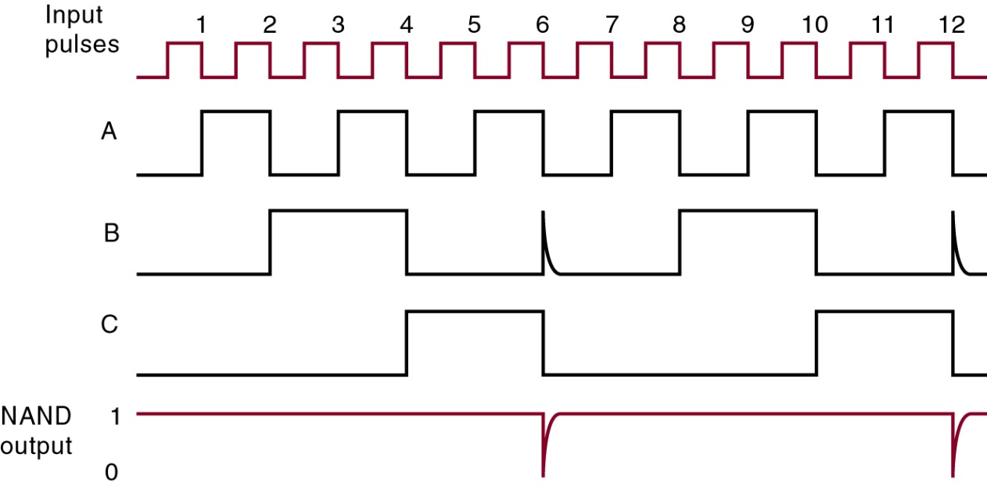
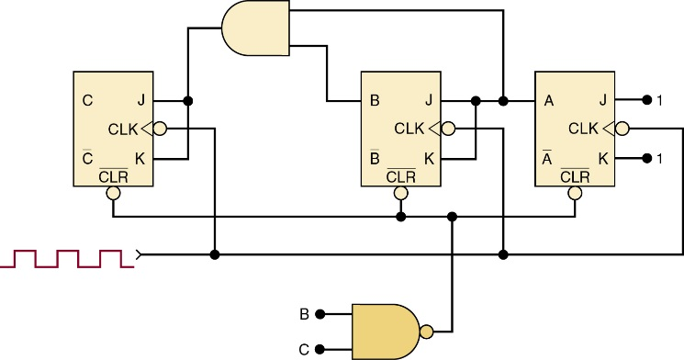
7-4 Counters with MOD Number <2^{N}
7-4 Counters with MOD Number <2^{N}
The basic counter can be modified to produce MOD numbers less than 2^{N}.
  By allowing the counter to skip states that are normally part of the counting sequence.
MOD-6 counter produced by clearing a MOD-8
counter when a count of six (110) occurs.
Digital Systems: Principles and Applications, 11/e
Ronald J. Tocci, Neal S. Widmer, Gregory L. Moss

Slide 16
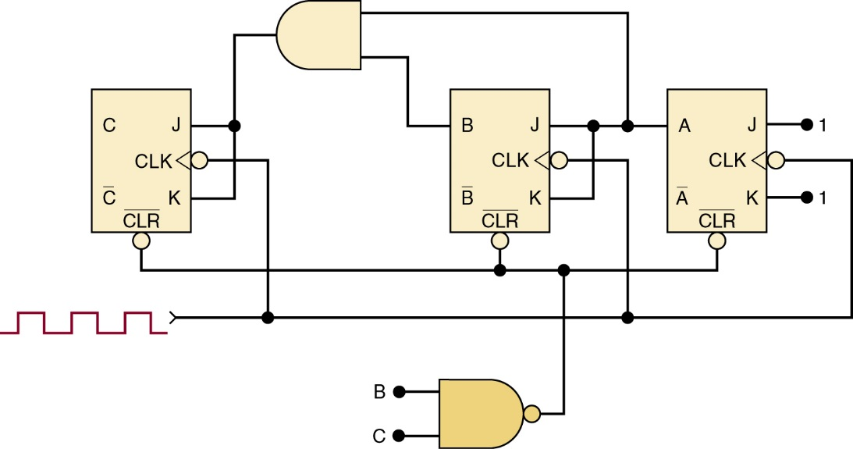
7-4 Counters with MOD Number <2^{N}
Changing the MOD number.
  Find the smallest MOD required so that 2^{N} is less
  than or equal to the requirement.
  Connect a NAND gate to the asynchronous CLEAR inputs of all FFs.
Determine which FFs are HIGH at the desired count and connect the outputs of these FFs to the NAND gate inputs.
Digital Systems: Principles and Applications, 11/e
Ronald J. Tocci, Neal S. Widmer, Gregory L. Moss

Slide 17
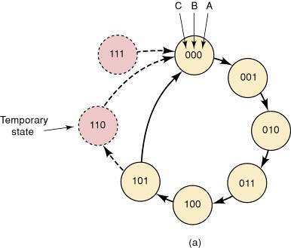
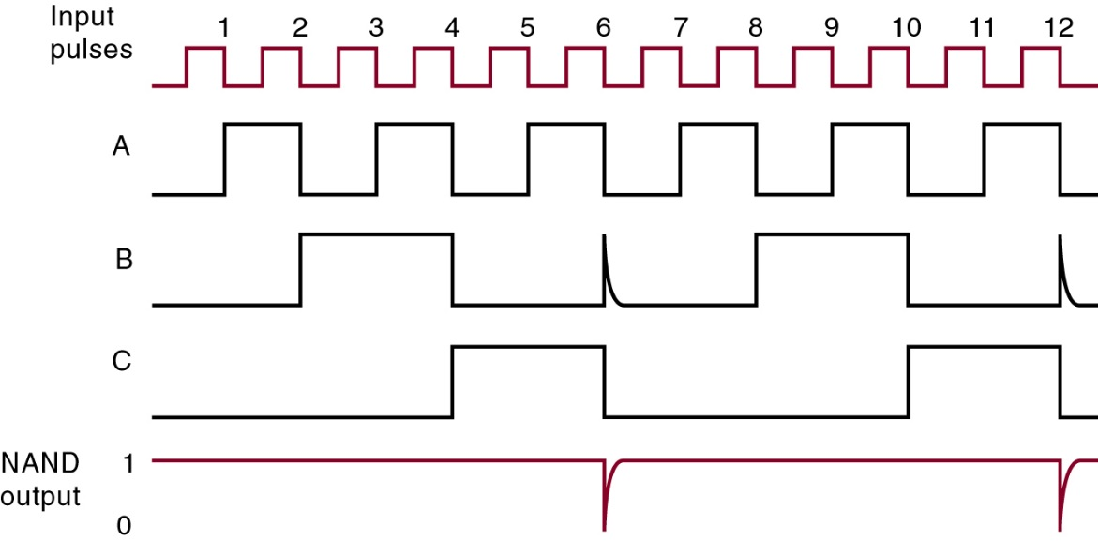
7-4 Counters with MOD Number < 2^{N}
7-4 Counters with MOD Number <2^{N}
State transition diagram for the MOD-6 counter
Each circle represents one of
the possible counter states.
Arrows indicate how one state changes to another—in response
to an input clock pulse.
There is no arrow to the 111 state as the counter can never advance to that state.
The 111 state can occur
on power-up when the FFs come up in random states.
Digital Systems: Principles and Applications, 11/e
Ronald J. Tocci, Neal S. Widmer, Gregory L. Moss

Slide 18
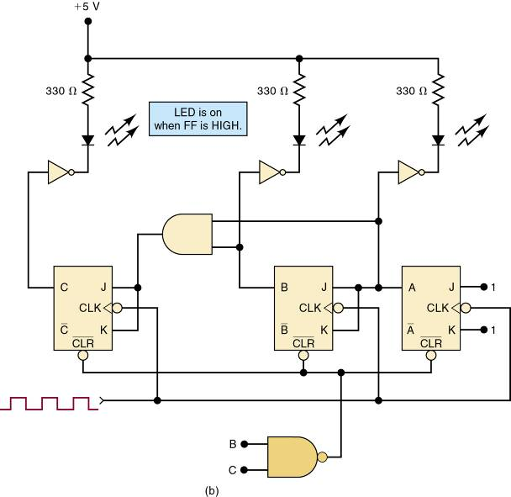
7-4 Counters with MOD Number < 2^{N}
7-4 Counters with MOD Number <2^{N}
Display of counter states is often done with an LED
The MOD-6 counter lights the LED on HIGH output.
Digital Systems: Principles and Applications, 11/e
Ronald J. Tocci, Neal S. Widmer, Gregory L. Moss

Slide 19
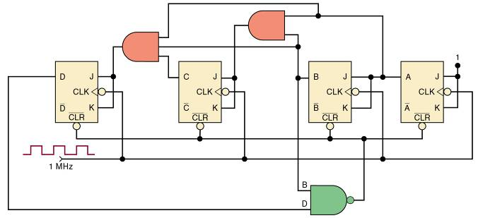
7-4 Counters with MOD Number <2^{N}
Decade counters are widely used for counting events, and displaying results in decimal form.
  A decade counter is any counter with 10 distinct states, regardless of the sequence.
  A BCD counter is a decade counter that counts from binary 0000 to 1001.
    Any MOD-10 counter is a decade counter.
Digital Systems: Principles and Applications, 11/e
Ronald J. Tocci, Neal S. Widmer, Gregory L. Moss

Slide 20
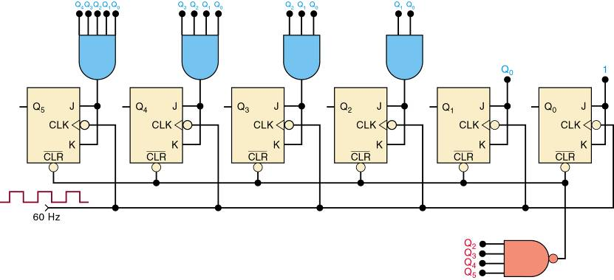
7-4 Counters with MOD Number <2^{N}
Mod-60 Counter
Digital Systems: Principles and Applications, 11/e
Ronald J. Tocci, Neal S. Widmer, Gregory L. Moss

Slide 21
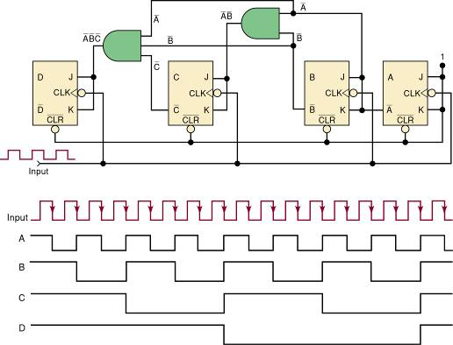
7-5 Synchronous Down and Up/Down Counters
A synchronous down counter is constructed in a similar manner to an up counter.
  It uses the inverted FF outputs to control the higher-order J, K inputs.
Synchronous, MOD-16, down counter and output waveforms.
Digital Systems: Principles and Applications, 11/e
Ronald J. Tocci, Neal S. Widmer, Gregory L. Moss

Slide 22
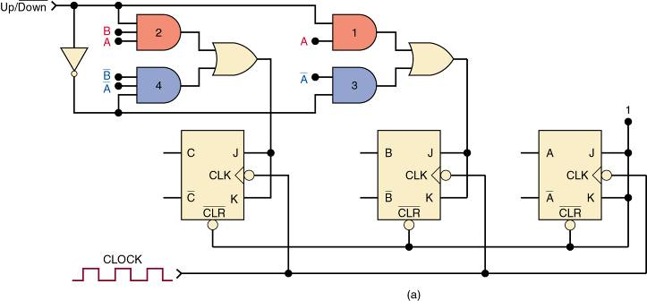
7-5 Synchronous Down and Up/Down Counters
In a parallel up/down counter, the control input controls the values fed to the J and K inputs of
the successive FFs.
  The normal FF outputs or the inverted FF outputs.
Digital Systems: Principles and Applications, 11/e
Ronald J. Tocci, Neal S. Widmer, Gregory L. Moss

Slide 23
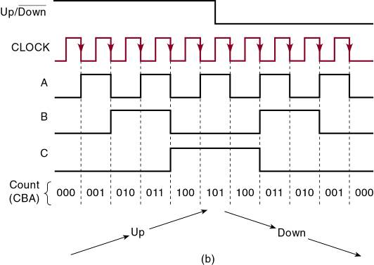
7-5 Synchronous Down and Up/Down Counters
For the first five clock pulses,
  The counter counts up.
Up/Down = 1.
For the last five pulses,
  The counter counts down.
Up/Down = 0.
Digital Systems: Principles and Applications, 11/e
Ronald J. Tocci, Neal S. Widmer, Gregory L. Moss

Slide 24
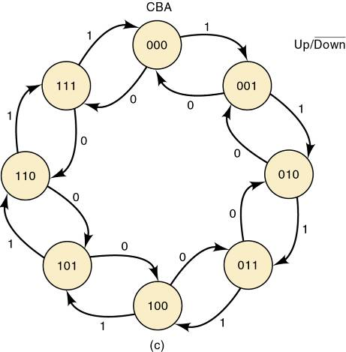
7-5 Synchronous Down and Up/Down Counters
Note that there are two arrows leaving each state’s bubble—a conditional transition.
The next state for this counter is dependent upon
the logic level applied to the control input.
Digital Systems: Principles and Applications, 11/e
Ronald J. Tocci, Neal S. Widmer, Gregory L. Moss

Slide 25
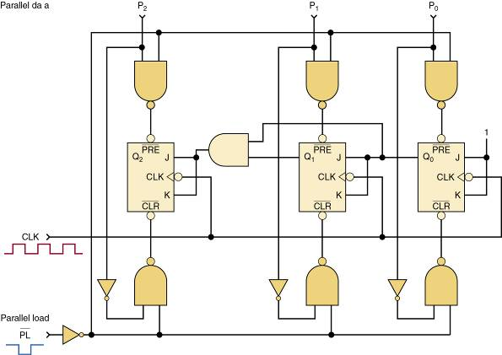
7-6 Presettable Counters
A presettable counter can be set to any desired starting point—synchronously or asynchronously.
  Preset is also called parallel loading the counter.
Parallel data inputs
Synchronous counter with asynchronous parallel load.
Digital Systems: Principles and Applications, 11/e
Ronald J. Tocci, Neal S. Widmer, Gregory L. Moss

Slide 26
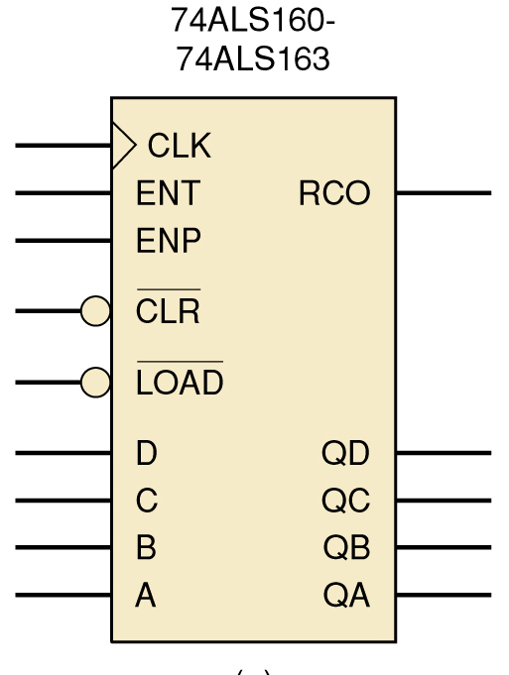
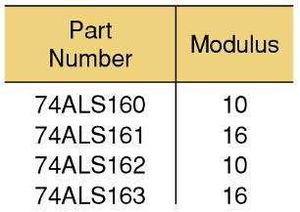
7-7 IC Asynchronous Counters
Counter contains four FFs.
FFs are triggered by a PGT
at the CLK input.
Active-low asynchronous CLEAR input.
Can be preset to any value by
applying an active-low LOAD
input to the A, B, C, and D inputs .
Digital Systems: Principles and Applications, 11/e
Ronald J. Tocci, Neal S. Widmer, Gregory L. Moss

Slide 27
7-7 IC Asynchronous Counters
This series of IC counter chips has one more output pin—RCO—an active-HIGH output is to detect (decode) the last or terminal
state of the counter.
Very useful in connecting two
or more counter chips in a multistage arrangement to
create larger counters.
Digital Systems: Principles and Applications, 11/e
Ronald J. Tocci, Neal S. Widmer, Gregory L. Moss

Slide 28
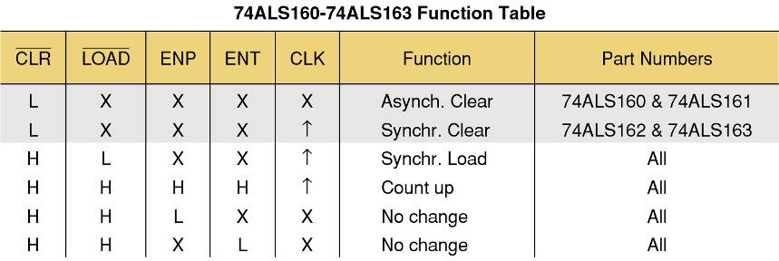
7-7 IC Asynchronous Counters
TTL 74ALS160 – 74ALS163 Function Table
Digital Systems: Principles and Applications, 11/e
Ronald J. Tocci, Neal S. Widmer, Gregory L. Moss

Slide 29
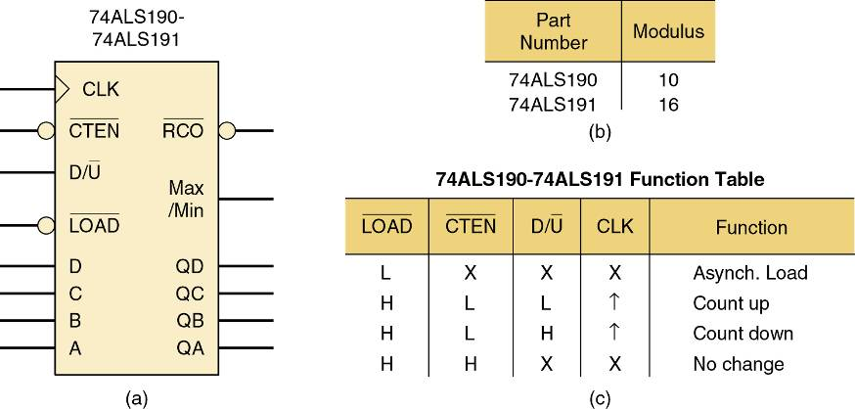
7-7 IC Asynchronous Counters
74ALS190 and 74ALS191 series ICs
are recycling, four-bit counters.
Digital Systems: Principles and Applications, 11/e
Ronald J. Tocci, Neal S. Widmer, Gregory L. Moss

Slide 30
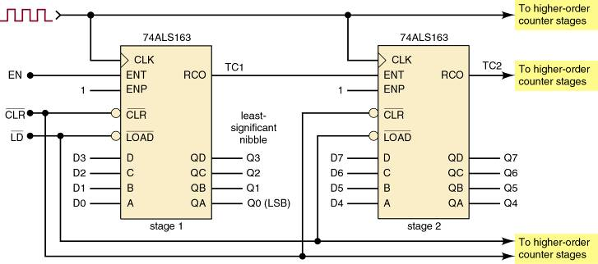
7-7 IC Asynchronous Counters
Many standard IC counters have been designed to make it easy to connect multiple chips to create circuits with a higher counting range.
  A multistage or cascading arrangement.
74ALS163s in a two-stage arrangement to extend the maximum counting range.
Digital Systems: Principles and Applications, 11/e
Ronald J. Tocci, Neal S. Widmer, Gregory L. Moss

Slide 31
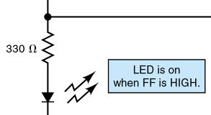
7-8 Decoding a Counter
Digital counters are often used in applications where the count represented by FF states must somehow be determined or displayed.
  One of the simplest means for displaying contents
  of a counter is connecting the FF output to an LED.
Active-HIGH decoder output.
The LED method becomes inconvenient as the
size (number of bits) of the counter increases.
It is much harder to decode the display mentally.
Digital Systems: Principles and Applications, 11/e
Ronald J. Tocci, Neal S. Widmer, Gregory L. Moss

Slide 32
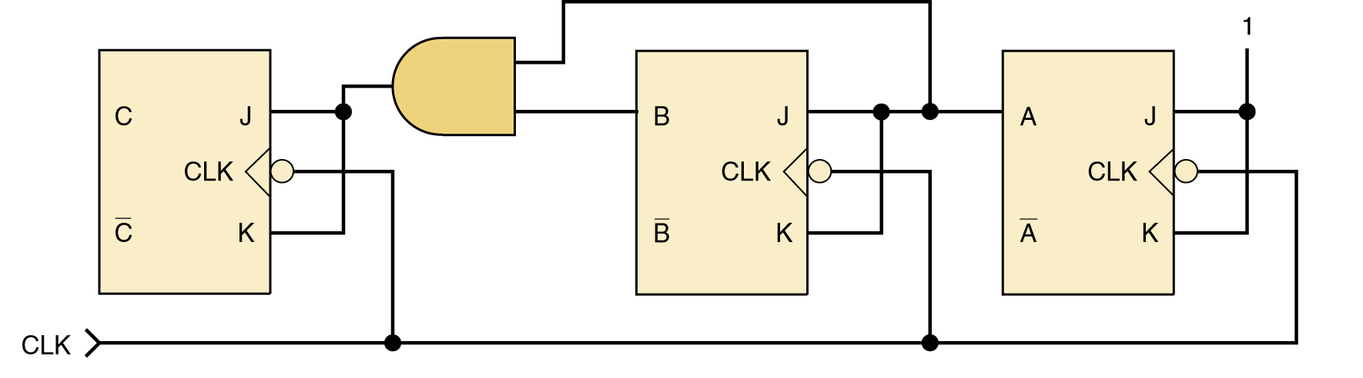
7-8 Decoding a Counter
Decoding is the conversion of a binary output to
a decimal value—a form immediately recognized.
  The active-HIGH decoder shown can be used to light an LED representing each decimal number 0 to 7.
Digital Systems: Principles and Applications, 11/e
Ronald J. Tocci, Neal S. Widmer, Gregory L. Moss

Slide 33
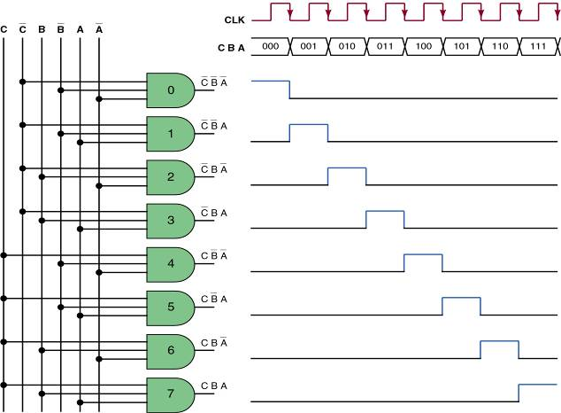
7-8 Decoding a Counter
Decoding is the conversion of a binary output to
a decimal value—a form immediately recognized.
MOD-8
Active-HIGH decoder output.
Digital Systems: Principles and Applications, 11/e
Ronald J. Tocci, Neal S. Widmer, Gregory L. Moss

Slide 34

7-8 Decoding a Counter
The active-HIGH decoder shown can
be changed to an active-LOW type.
  Active-LOW decoding is obtained by
  replacing the AND gates with NAND gates.
The decoder outputs now produce a normally HIGH signal, which goes LOW only when
the number being decoded occurs.
Digital Systems: Principles and Applications, 11/e
Ronald J. Tocci, Neal S. Widmer, Gregory L. Moss

Slide 35
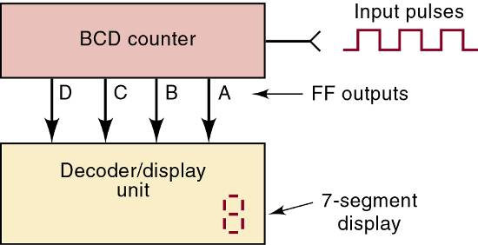
7-8 Decoding a Counter
A BCD counter has 10 states, decoded to provide 10 outputs corresponding to decimal digits 0 – 9.
  Represented by the states of the counter FFs.
  The 10 outputs can control 10 individual indicator LEDs for a visual display.
Instead of 10 separate LEDs, BCD counters usually have their count displayed on
a single display device.
Digital Systems: Principles and Applications, 11/e
Ronald J. Tocci, Neal S. Widmer, Gregory L. Moss

Slide 36
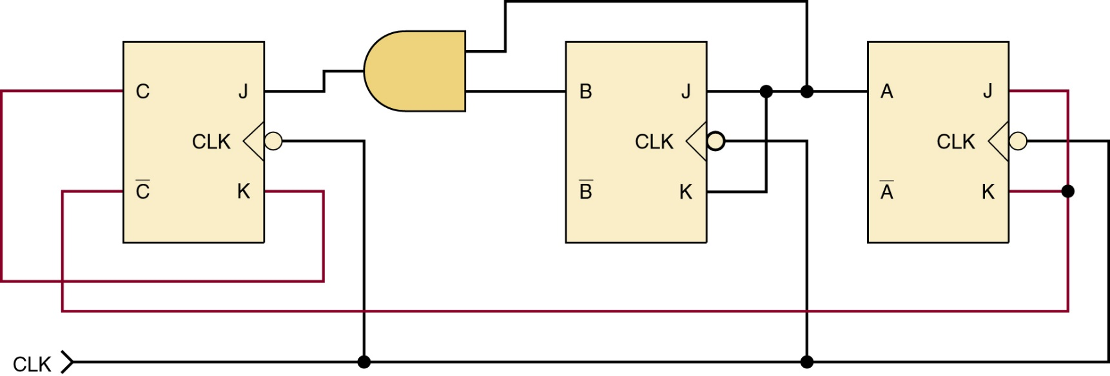
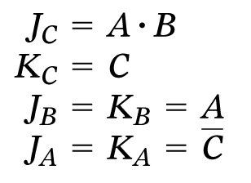
7-9 Analyzing Synchronous Counters
Synchronous up counter.
Control input expressions.
Digital Systems: Principles and Applications, 11/e
Ronald J. Tocci, Neal S. Widmer, Gregory L. Moss

Slide 37
7-9 Analyzing Synchronous Counters
Synchronous counters can be custom-designed
to generate any desired count sequence.
Synchronous
up-counter.
Control input expressions.
Digital Systems: Principles and Applications, 11/e
Ronald J. Tocci, Neal S. Widmer, Gregory L. Moss

Slide 38
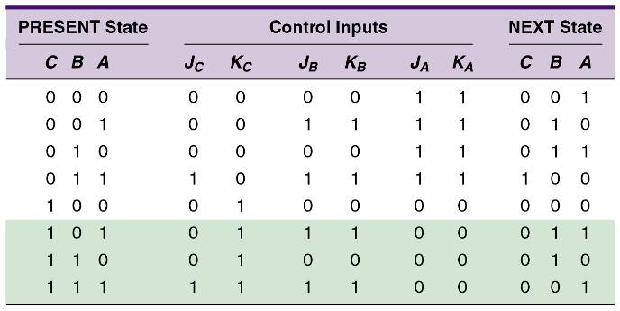
7-9 Analyzing Synchronous Counters
Analyze counter designs of this type by predicting
FF control inputs for each state of the counter.
  A PRESENT state/NEXT state table is very useful for this purpose.
Digital Systems: Principles and Applications, 11/e
Ronald J. Tocci, Neal S. Widmer, Gregory L. Moss

Slide 39
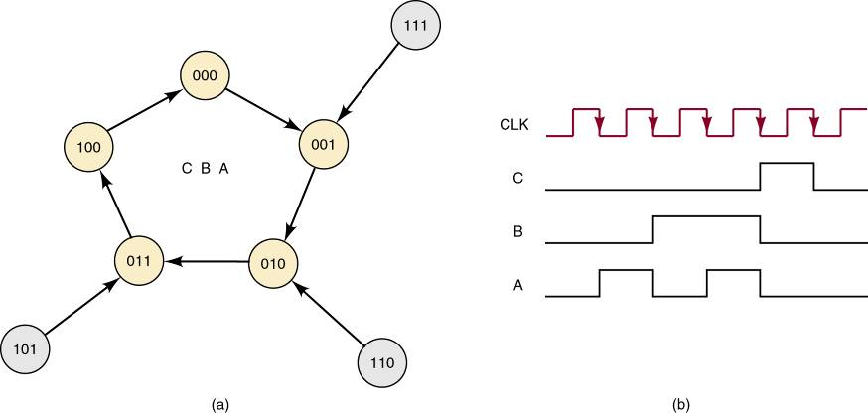
7-9 Analyzing Synchronous Counters
Synchronous up counter state
transition diagram and waveform.
Highlighted information
indicates this counter
design is self-correcting.
Digital Systems: Principles and Applications, 11/e
Ronald J. Tocci, Neal S. Widmer, Gregory L. Moss

Slide 40
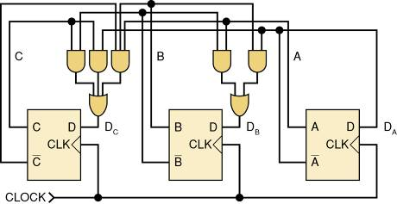
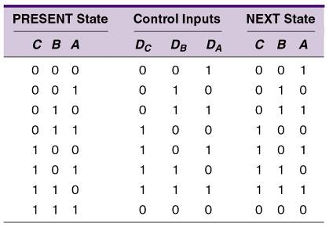
7-9 Analyzing Synchronous Counters
Synchronous counter built using D-type FFs.
Control circuitry will typically be more complex than an equivalent JK-type counter,
The number of synchronous inputs to control
is reduced by half
Digital Systems: Principles and Applications, 11/e
Ronald J. Tocci, Neal S. Widmer, Gregory L. Moss

Slide 41
7-10 Synchronous Counter Design
Common design method using J-K flip-flops in
a synchronous counter configuration.
  Determine the desired number of bits (FFs) and the desired counting sequence.
  Draw the state transition diagram showing all possible states—including those not part of the desired counting sequence.
  Use the state transition diagram to set up a table that lists all PRESENT states and their NEXT states.
  Add a column for each J and K input & indicate levels required to produce transition to the NEXT state.
  Design the logic circuits to generate levels required at each input, and implement the final expressions.
Digital Systems: Principles and Applications, 11/e
Ronald J. Tocci, Neal S. Widmer, Gregory L. Moss

Slide 42
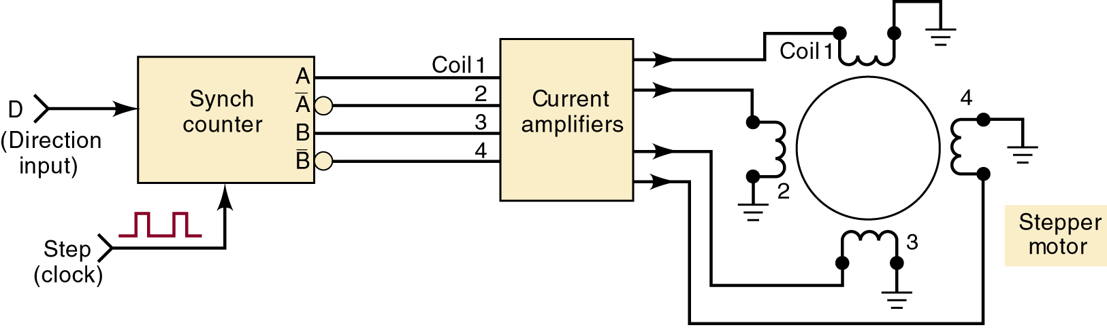

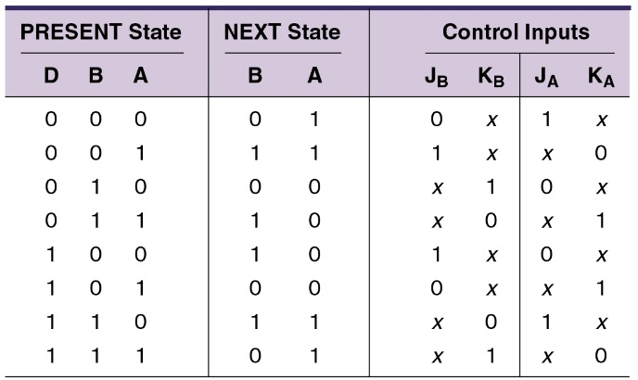
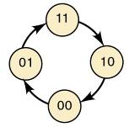

7-10 Synchronous Counter Design
A stepper motor rotates in steps, not continuous motion—typically 15 degrees per step.
  A practical application of synchronous counter design.
    Reversible, depending on output level.
Digital Systems: Principles and Applications, 11/e
Ronald J. Tocci, Neal S. Widmer, Gregory L. Moss

Slide 43

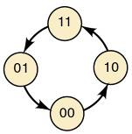

7-10 Synchronous Counter Design
A stepper motor rotates in steps, not continuous motion—typically 15 degrees per step.
  A practical application of synchronous counter design.
    Reversible, depending on output level.
Digital Systems: Principles and Applications, 11/e
Ronald J. Tocci, Neal S. Widmer, Gregory L. Moss

Slide 44
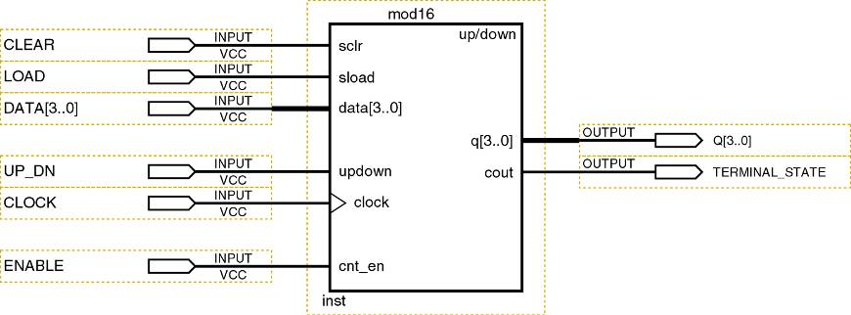
7-11 Altera Library Functions for Counters
The Quartus Block Editor can program a PLD with any counter using flip-flops and gates.
  These macro-functions are in the maxplus2 library.
A full-featured MOD-16 up/down counter.
Digital Systems: Principles and Applications, 11/e
Ronald J. Tocci, Neal S. Widmer, Gregory L. Moss

Slide 45
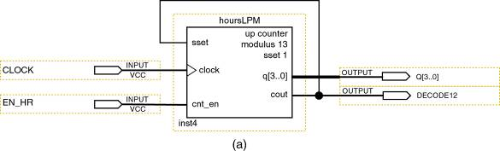
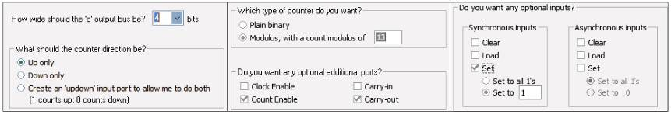
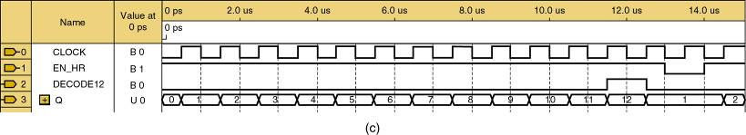
7-11 Altera Library Functions for Counters
Digital clock hours counter—block diagram,
MegaWizard settings & simulation results.
Digital Systems: Principles and Applications, 11/e
Ronald J. Tocci, Neal S. Widmer, Gregory L. Moss

Slide 46
7-12 HDL Counters
Methods to describe counter circuits using HDL primarily use synchronous techniques.
  All flip-flops update simultaneously in response to
  the same clock event.
  All bits in a count sequence go from their PRESENT state to their prescribed NEXT state simultaneously,
State Transition Description Methods
  The PRESENTstate/NEXT state table is the equivalent of the truth table.
Digital Systems: Principles and Applications, 11/e
Ronald J. Tocci, Neal S. Widmer, Gregory L. Moss

Slide 47
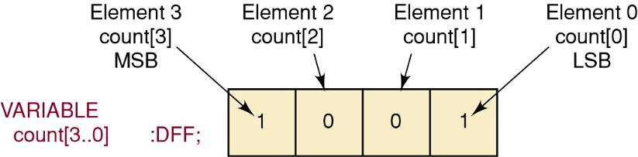
7-12 HDL Counters
State descriptions in AHDL
  The first important step is to declare the counter output pins properly— as a bit array.
Digital Systems: Principles and Applications, 11/e
Ronald J. Tocci, Neal S. Widmer, Gregory L. Moss

Slide 48
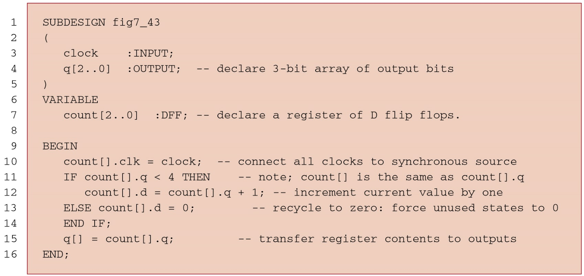
7-12 HDL Counters
State descriptions in AHDL
The current state of the counter is evaluated (count[ ].q)
on line 11, and if it is less than the highest desired count
value, it uses the description count[ ].d count.q + 1 (line 12).
Digital Systems: Principles and Applications, 11/e
Ronald J. Tocci, Neal S. Widmer, Gregory L. Moss

Slide 49
7-12 HDL Counters
State descriptions in AHDL
When the counter has reached the highest desired state
(or higher), the IF statement test will be false, resulting in a
NEXT-state input value of zero, which recycles the counter.
Digital Systems: Principles and Applications, 11/e
Ronald J. Tocci, Neal S. Widmer, Gregory L. Moss

Slide 50
7-13 Wiring HDL Modules Together
Designing large digital systems is much easier if the system is subdivided into smaller, manageable modules that are interconnected.
  The essence of the concept of hierarchical design.
Consider a recycling, MOD-100 BCD counter
with a synchronous clear.
  Creating a MOD-10 BCD counter module, cascading synchronously two of thesein a higher-level design
  file is the easiest way to do this.
Digital Systems: Principles and Applications, 11/e
Ronald J. Tocci, Neal S. Widmer, Gregory L. Moss

Slide 51
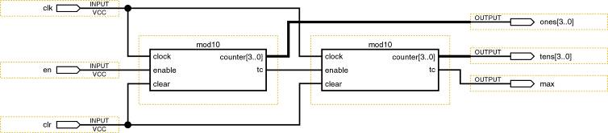
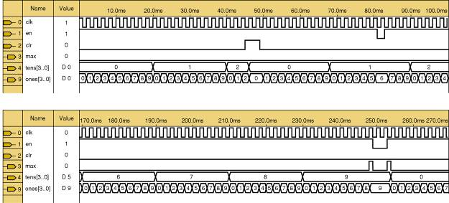
7-13 Wiring HDL Modules Together
Block diagram design and simulation
results for MOD-100 BCD counter design.
Digital Systems: Principles and Applications, 11/e
Ronald J. Tocci, Neal S. Widmer, Gregory L. Moss

Slide 52
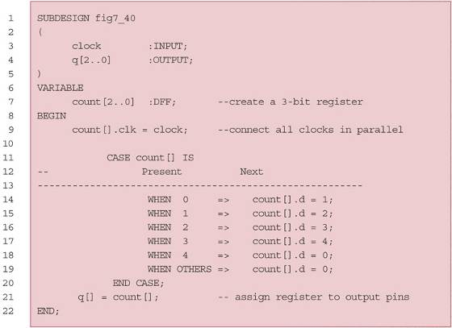
7-13 Wiring HDL Modules Together
Decoding the AHDL MOD-5 counter
Digital Systems: Principles and Applications, 11/e
Ronald J. Tocci, Neal S. Widmer, Gregory L. Moss

Slide 53
7-14 State Machines
The term state machine refers to a circuit that sequences through a set of predetermined states.
  Controlled by a clock and other input signals.
The term counter is used for sequential circuits that have a regular numeric count sequence.
  The things that are counted are actually clock pulses.
    But the pulses may represent many kinds of events.
The general distinction between the two terms:
  A counter is commonly used to count events,
  A state machine is commonly used to control events.
Digital Systems: Principles and Applications, 11/e
Ronald J. Tocci, Neal S. Widmer, Gregory L. Moss

Slide 54
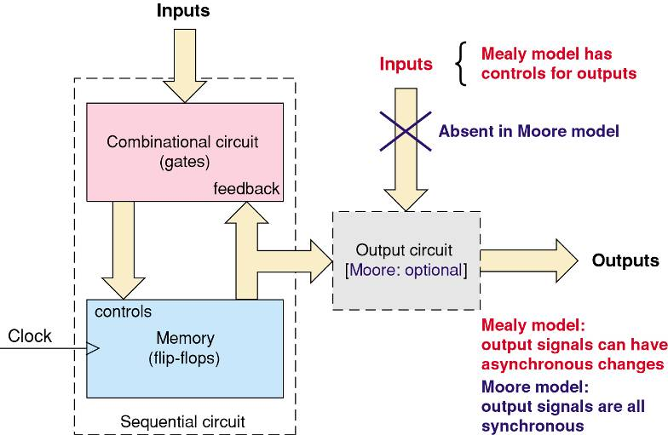
7-14 State Machines
Block diagram for counters and state machines.
Digital Systems: Principles and Applications, 11/e
Ronald J. Tocci, Neal S. Widmer, Gregory L. Moss

Slide 55
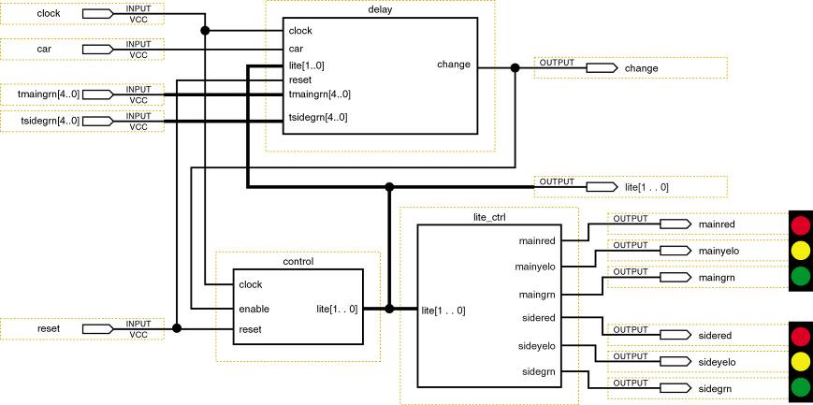
7-14 State Machines
Traffic light controller state machine.
Digital Systems: Principles and Applications, 11/e
Ronald J. Tocci, Neal S. Widmer, Gregory L. Moss

Slide 56
7-15 Register Data Transfer
The various types of registers can be classified according to…
  The manner in which data can be entered into the register for storage.
  The manner in which data are outputted from the register.
Serial data flow through a register is generally called shifting—either to the left or to the right.
  Serial output data fed back to the input of the same register is called a data rotate.
Parallel inputting of data is often described as a register load.
Digital Systems: Principles and Applications, 11/e
Ronald J. Tocci, Neal S. Widmer, Gregory L. Moss

Slide 57
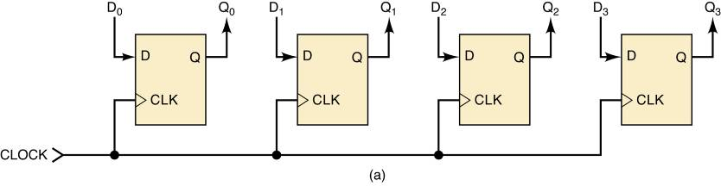
7-15 & 16 Register Data Transfer / Integrated-Circuit Registers
74ALS174/74HC174
Parallel in/parallel out (PIPO)
A group of flip-flops that can store multiple
bits simultaneously and in which all bits of
the stored binary value are directly available.
Digital Systems: Principles and Applications, 11/e
Ronald J. Tocci, Neal S. Widmer, Gregory L. Moss

Slide 58
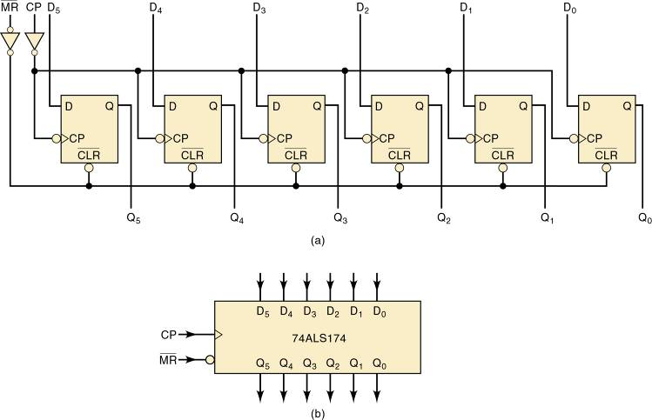
7-15 & 16 Register Data Transfer / Integrated-Circuit Registers
74ALS174/74HC174
Digital Systems: Principles and Applications, 11/e
Ronald J. Tocci, Neal S. Widmer, Gregory L. Moss

Slide 59
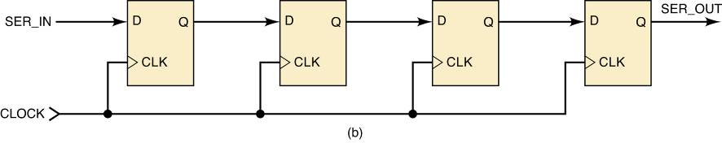
7-15 & 16 Register Data Transfer / Integrated-Circuit Registers
74ALS166/74HC166
Serial in/serial out (SISO)
Data loaded one bit at a time moves one bit at a time,
with each clock pulse through the flip-flops toward
the other end of the register, and exit one bit at
a time in the same order as originally loaded.
Digital Systems: Principles and Applications, 11/e
Ronald J. Tocci, Neal S. Widmer, Gregory L. Moss

Slide 60

7-15 & 16 Register Data Transfer / Integrated-Circuit Registers
74ALS166/74HC166
Circuit Diagram
Digital Systems: Principles and Applications, 11/e
Ronald J. Tocci, Neal S. Widmer, Gregory L. Moss

Slide 61


7-15 & 16 Register Data Transfer / Integrated-Circuit Registers
74ALS166/74HC166
Logic
Symbol
Function
Table
Digital Systems: Principles and Applications, 11/e
Ronald J. Tocci, Neal S. Widmer, Gregory L. Moss

Slide 62

7-15 & 16 Register Data Transfer / Integrated-Circuit Registers
74ALS165/74HC165
8-bit parallel in/serial out (PISO)
Serial shifting is always synchronous, as the clock is
required to ensure the input data moves only one
bit at a time with each appropriate clocking edge.
Digital Systems: Principles and Applications, 11/e
Ronald J. Tocci, Neal S. Widmer, Gregory L. Moss

Slide 63


7-15 & 16 Register Data Transfer / Integrated-Circuit Registers
74ALS165/74HC165
8-bit parallel in/serial out (PISO)
Digital Systems: Principles and Applications, 11/e
Ronald J. Tocci, Neal S. Widmer, Gregory L. Moss

Slide 64


7-15 & 16 Register Data Transfer / Integrated-Circuit Registers
74ALS164/74HC164
8-bit serial in/parallel out (SIPO)
Digital Systems: Principles and Applications, 11/e
Ronald J. Tocci, Neal S. Widmer, Gregory L. Moss

Slide 65

7-15 & 16 Register Data Transfer / Integrated-Circuit Registers
74ALS164/74HC164
8-bit serial in/parallel out (SIPO)
Digital Systems: Principles and Applications, 11/e
Ronald J. Tocci, Neal S. Widmer, Gregory L. Moss

Slide 66
7-17 Shift Register Counters
Shift-register counters use feedback—the output of the last FF in the register is connected back to the first FF in some way.
Digital Systems: Principles and Applications, 11/e
Ronald J. Tocci, Neal S. Widmer, Gregory L. Moss

Slide 67




7-17 Shift Register Counters
A ring counter is a circulating shift register connected so the last FF shifts its value to the first.
Digital Systems: Principles and Applications, 11/e
Ronald J. Tocci, Neal S. Widmer, Gregory L. Moss

Slide 68

7-17 Shift Register Counters
To operate properly, a ring counter must start off with only one FF in the 1 state and all the others in the 0 state.
  As power-up starting states will be unpredictable, the counter is preset before clock pulses are applied.
Circuit for ensuring the ring counter starts in the 1000 state on power-up.
Digital Systems: Principles and Applications, 11/e
Ronald J. Tocci, Neal S. Widmer, Gregory L. Moss

Slide 69



7-17 Shift Register Counters
In the Johnson or twisted-ring counter inverted output of the last FF is connected to the input of the first FF.
Digital Systems: Principles and Applications, 11/e
Ronald J. Tocci, Neal S. Widmer, Gregory L. Moss

Slide 70


7-17 Shift Register Counters
For a given MOD number, a Johnson counter requires only half the FFs a ring counter requires.
  It requires decoding gates—a ring counter does not.
A Johnson counter uses one logic gate to decode for each count.
  Each gate requires only two inputs, regardless of
  the number of FFs in the counter.
Digital Systems: Principles and Applications, 11/e
Ronald J. Tocci, Neal S. Widmer, Gregory L. Moss

Slide 71
7-17 Shift Register Counters
Very few ring counters or Johnson counters are available as ICs.
  It is relatively simple to wire a shift-register IC as either a ring counter or a Johnson counter.
Some of the CMOS Johnson-counter ICs include the complete decoding circuitry on the same chip as the counter.
  (74HC4017, 74HC4022)
Digital Systems: Principles and Applications, 11/e
Ronald J. Tocci, Neal S. Widmer, Gregory L. Moss

Slide 72
7-18 Troubleshooting
Flip-flops, counters, and registers are the major components in sequential logic system.
  Sequential systems suffer from the same types of failures as do combinational systems.
    Open circuits, shorts, internal IC faults, etc.
Basic troubleshooting procedures still apply.
  Observe system operation.
  Use analytical reasoning to determine possible causes.
  Use test equipment to isolate the exact fault.
Digital Systems: Principles and Applications, 11/e
Ronald J. Tocci, Neal S. Widmer, Gregory L. Moss

Slide 73
7-20 HDL Registers
HDL techniques use bit arrays to describe register data & transfer the data in parallel or serial format.
Concatenation—grouping together in a specific sequence—of desired set of data bits can be used to describe data movement for serial shifting.
Digital Systems: Principles and Applications, 11/e
Ronald J. Tocci, Neal S. Widmer, Gregory L. Moss

Slide 74

7-20 HDL Registers
Four flip-flops performing transfer operations
of parallel load, shift right, shift left, and hold data.
Bits are transferred synchronously, which means
they all move simultaneously on a single clock edge.
Digital Systems: Principles and Applications, 11/e
Ronald J. Tocci, Neal S. Widmer, Gregory L. Moss

Slide 75
7-21 HDL Ring Counters
A ring counter is a shift register that circulates
a single active logic level through all its FFs.
  Modulus is equal to the number of FFS in the register.
    There are always many unused and invalid states.
With planning, we can ensure the counter reaches the desired sequence—no matter the initial state.
  Regardless of the state to which the counter initializes, it eventually fills with zeros.
    At which time, logic shifts in a HIGH to start the ring sequence.
Digital Systems: Principles and Applications, 11/e
Ronald J. Tocci, Neal S. Widmer, Gregory L. Moss

Slide 76

7-21 HDL Ring Counters
In the AHDL code shown, lines 11 & 12 control
the serial input using the strategy just described.
  The (==) operator evaluates whether the expressions on each side are equal or not.
Digital Systems: Principles and Applications, 11/e
Ronald J. Tocci, Neal S. Widmer, Gregory L. Moss

Slide 77
7-22 HDL One-Shots
The concept of a counter can be applied to implement a digital one-shot using HDL.
  A nonretriggerable one-shot ignores the trigger
  input pulse output is still active.
  A retriggerable one-shot starts a pulse in response
  to a trigger.
    Internal pulse timer restarts each time a subsequent trigger edge occurs before the pulse is complete.
Digital Systems: Principles and Applications, 11/e
Ronald J. Tocci, Neal S. Widmer, Gregory L. Moss

Slide 78
END

